Slide 1

Overview
http://compcogscisydney.org/psyc2071/
Danielle Navarro

Slide 2


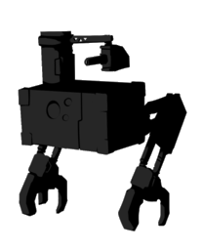
Cognitive Psychology
Part 1: Dani Navarro
L1: Introduction
L2: Attention
L3: Similarity
L4: Reasoning
L5: A case study
Part 2: Marcus Taft
Next!

Slide 3

“Could we have a brief recap?”

Slide 4
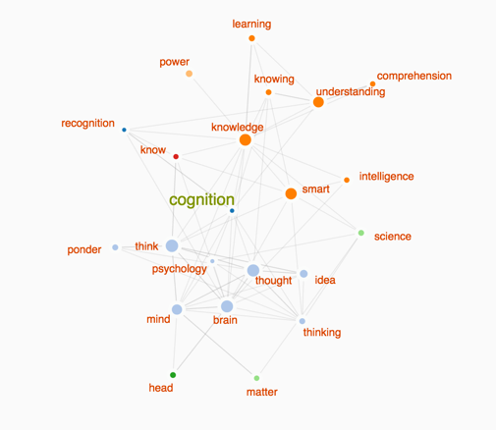
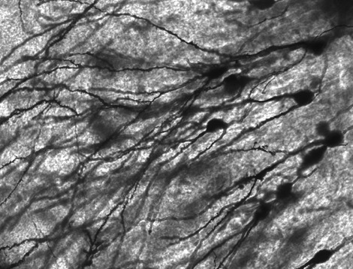
Lecture 1: Introduction

Slide 5
Goal:
To discuss the history of cognitive psychology and introduce key ideas in how it is studied
Ideas:
Behaviourism as a response to introspection
Key ideas in behaviourism (methodological & radical)
Cognitive revolution as a response to behaviourism
Methods for measuring cognition
The “computational metaphor” views cognition as “information processing” (does not say mind = laptop!)
Marr’s levels of analysis

Slide 6
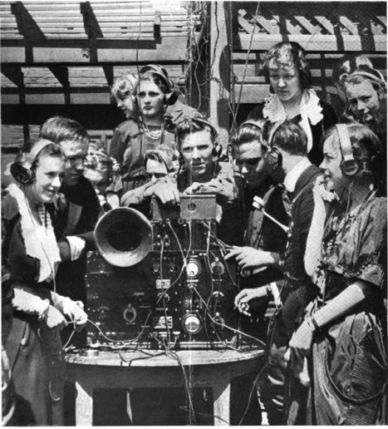
Lecture 2: Attention

Slide 7
Goal:
To discuss different “kinds” of attention, with a focus on results in auditory & visual attention, and visual search
Ideas:
Definitions for different kinds of attention (how many targets, what kind of target, how is attention controlled)
Audition: cocktail party problem & early vs late selection
Visual analogs (e.g., negative priming vs semantic interference)
Visual search: serial search vs parallel search, pop-out effects, feature integration theory & illusory conjunction

Slide 8
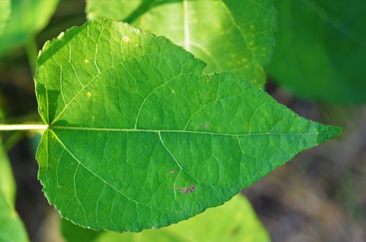


Lecture 3: Similarity

Slide 9
Goal:
What is similarity and what is it good for?
Ideas:
The “snowflake problem” means we need similarity
How to measure similarity
Links between similarity, generalisation & categorisation
Geometric theory of similarity & Shepard’s law
Featural theory of similarity & explanation of asymmetry
Structural alignment & the MIPs vs MOPs effect
Transformational similarity & explanation of asymmetry (+ experimental evidence)

Slide 10
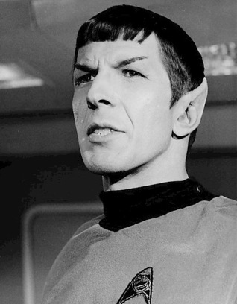
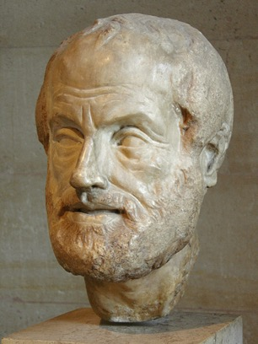
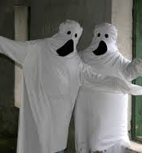
Lecture 4: Reasoning

Slide 11
Goal:
How do people reason and evaluate arguments?
Ideas:
Difference between induction and deduction
Valid vs invalid arguments: MP, MT, DA, DC
Wason selection task (plus the “deontic” version of it)
Inductive phenomena: premise-conclusion similarity, premise diversity, premise monotonicity
Fallacies: argument from ignorance depends on epistemic closure; circular arguments appeal to explanatory systems and depend on the strength of the alternative

Slide 12






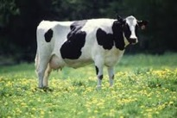
Lecture 5: The case study

Slide 13
Goal:
Link the previous lectures: show how reasoning uses similarity, attention & social cognition
Ideas:
Similarity calls attention to a target category, which drives the premise non-monotonicity effect
Explanation: People use similarity to make persuasive arguments, so this makes sense
Prediction: helpful person -> non-monotonicity; unhelpful world -> monotonicity
Experiment: Manipulate people’s beliefs about the origin of the data and show this changes their reasoning

Slide 14

“Could we have some examples of questions to help us study?”
(besides the quizzes, obviously!)

Slide 15

Lecture 1
What is the difference between…
… perception and cognition?
… theoretical and methodological behaviourism?
… behaviourism and cognitivism?
… computational, algorithmic & implementation levels?
What methods are used to measure cognition?
What is the computational metaphor?
Why do we use the computational metaphor?
Is the computational metaphor consistent with behaviourism?

Slide 16
Lecture 2
Can you explain the different “kinds of attention”?
What do we learn from “shadowing tasks”?
What is the difference between early and late selection theories?
Why does reaction time increase with “set size” for serial search but stay flat for “parallel search”?
What kind of visual searches can we do in parallel?
How does feature integration theory explain these illusory conjunctions?

Slide 17

Lecture 3
Why does cognition rely on similarity?
Explain the difference between …
… geometric and featural theories
… structural alignment and transformational theories
Describe different ways to measure similarity?
What does “the universal law of generalisation” say?
What’s the difference between MIPs and MOPs?
Why is the similarity from A to B not always the same as the similarity from B to A?
Do different theories explain this differently?

Slide 18

Lecture 4
How are induction and deduction different?
What is the meaning of “modus ponens”, etc?
Is deductive reasoning always equally easy/hard?
… does argument structure matter (e.g., MP, MT)
… does it matter if we use an “indicative” or “deontic” conditional? Why?
Describe the “premise monotonicity” effect
When is an argument from ignorance acceptable?
When is a circular argument more acceptable to people?

Slide 19
Lecture 5
How do similarity & attention relate to reasoning?
Why do we think social cognition plays a role?
What does this mean for (non)monotonicity?
What were the experimental manipulations?
What was the dependent variable?
What were the results of the study?
What can be concluded from it?
What are the limitations of the study?

Slide 20

The relationship between reaction time and stimulus transformations

Slide 21
Transform(A →B) = 2 steps
copy
stretch
Many transformations
= very DISSIMILAR
= EASY to distinguish
= FAST (small) reaction time
A
B
Transform(B → A) = 1 step
Few transformations
= very SIMILAR
= HARD to distinguish
= SLOW (large) reaction time
delete
B
A

Slide 22

The four deductive reasoning scenarios (MP, MT, DA, AC)

Slide 23
Valid arguments:
(1) Modus ponens is when you “affirm the antecedent”….
If today is a Thursday, then it is a weekday
Today is a Thursday
Therefore today is a weekday
(2) Modus tollens is when you “deny the consequent”….
If today is a Thursday, then it is a weekday
Today is NOT a weekday
Therefore today is not Thursday

Slide 24
Invalid arguments:
(3) Affirmation of the consequent…
If today is a Monday, then it is a weekday
Today is a weekday
Therefore today is Monday
(4) Denial of the antecedent…
If today is a Monday, then it is a weekday
Today is NOT a Monday
Therefore today is not a weekday

Slide 25

Premise monotonicity vs premise non-monotonicity

Slide 26
Here is a colour I like
Do I like this colour?
Maybe??? Purple and red are a little bit similar so it’s possible but hard to say for sure

Slide 27
Here is a colour I like
Do I like this colour?
I like all the colours?
Adding more examples of “things I like” increases your belief that I like “red”
PREMISE MONOTONICITY

Slide 28
Here is a colour I like
Do I like this colour?

Slide 29
Here is a colour I like
Do I like this colour?
Apparently I only like purple?
Adding more examples of “things I like” decreases your belief that I like “red”
PREMISE NON-MONOTONICITY

Slide 30

Category sampling and property sampling (tutorials)

Slide 31
Some parts of this explanation go beyond what was in the tutorials. The new content is NOT examinable

Slide 32
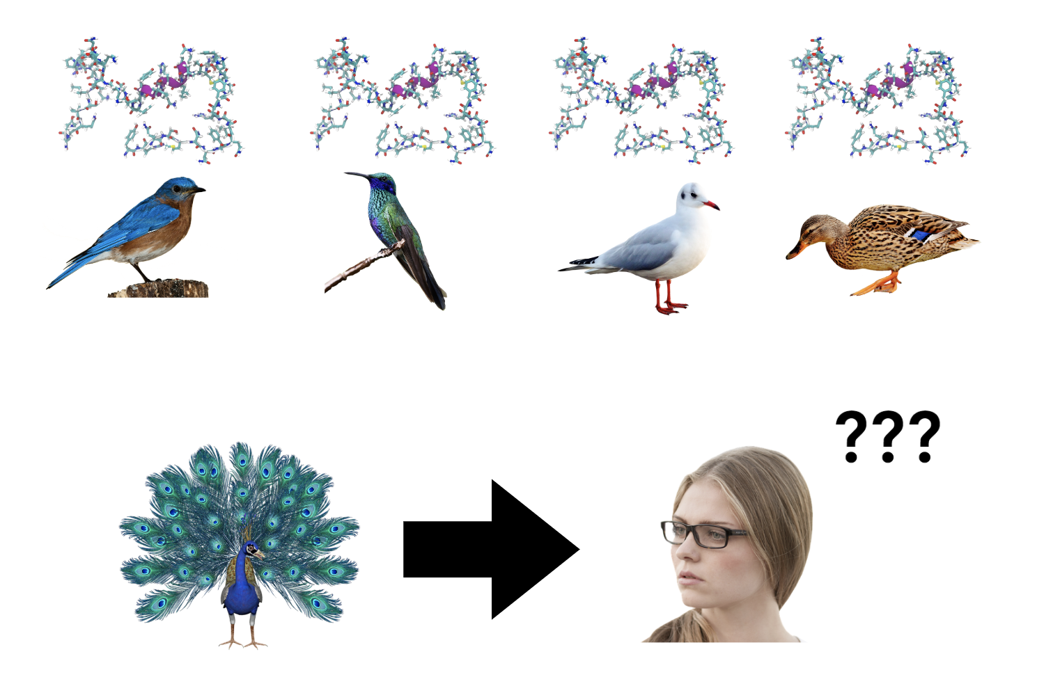

Slide 33
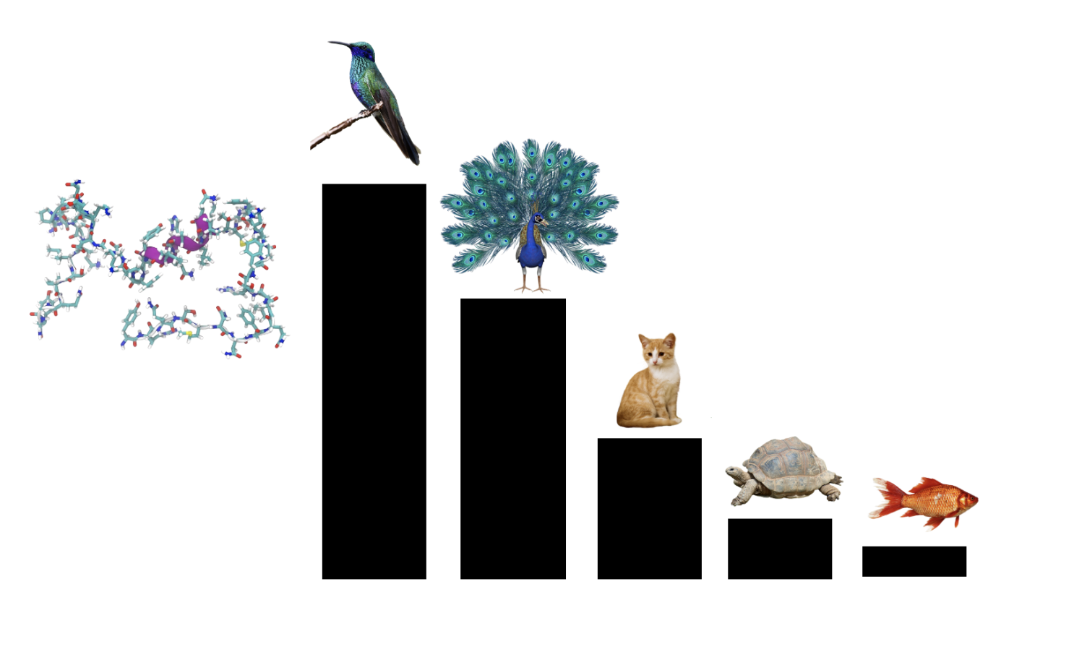

Slide 34
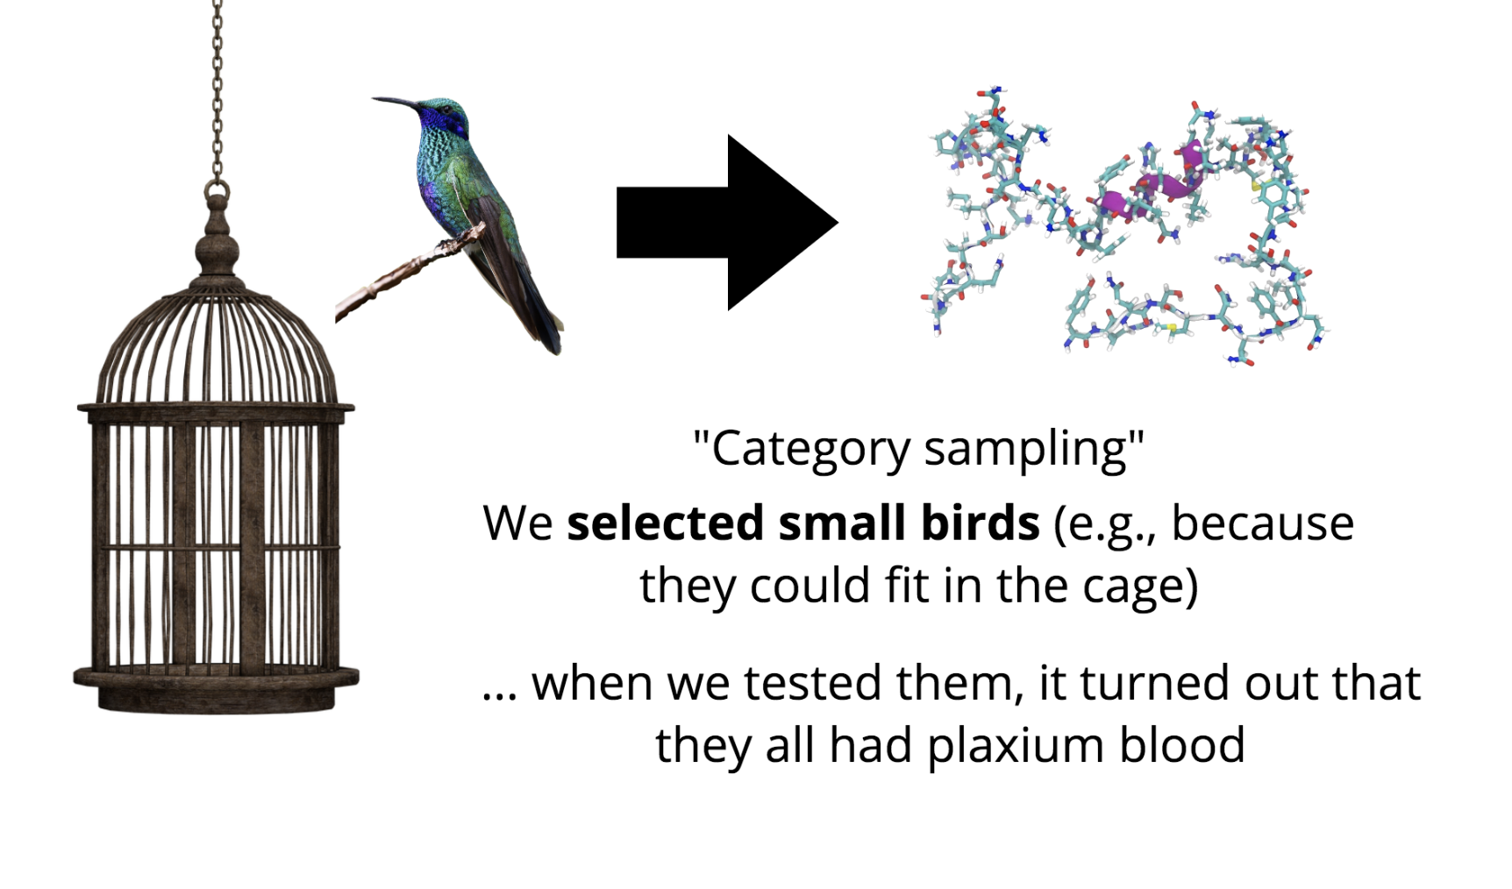

Slide 35
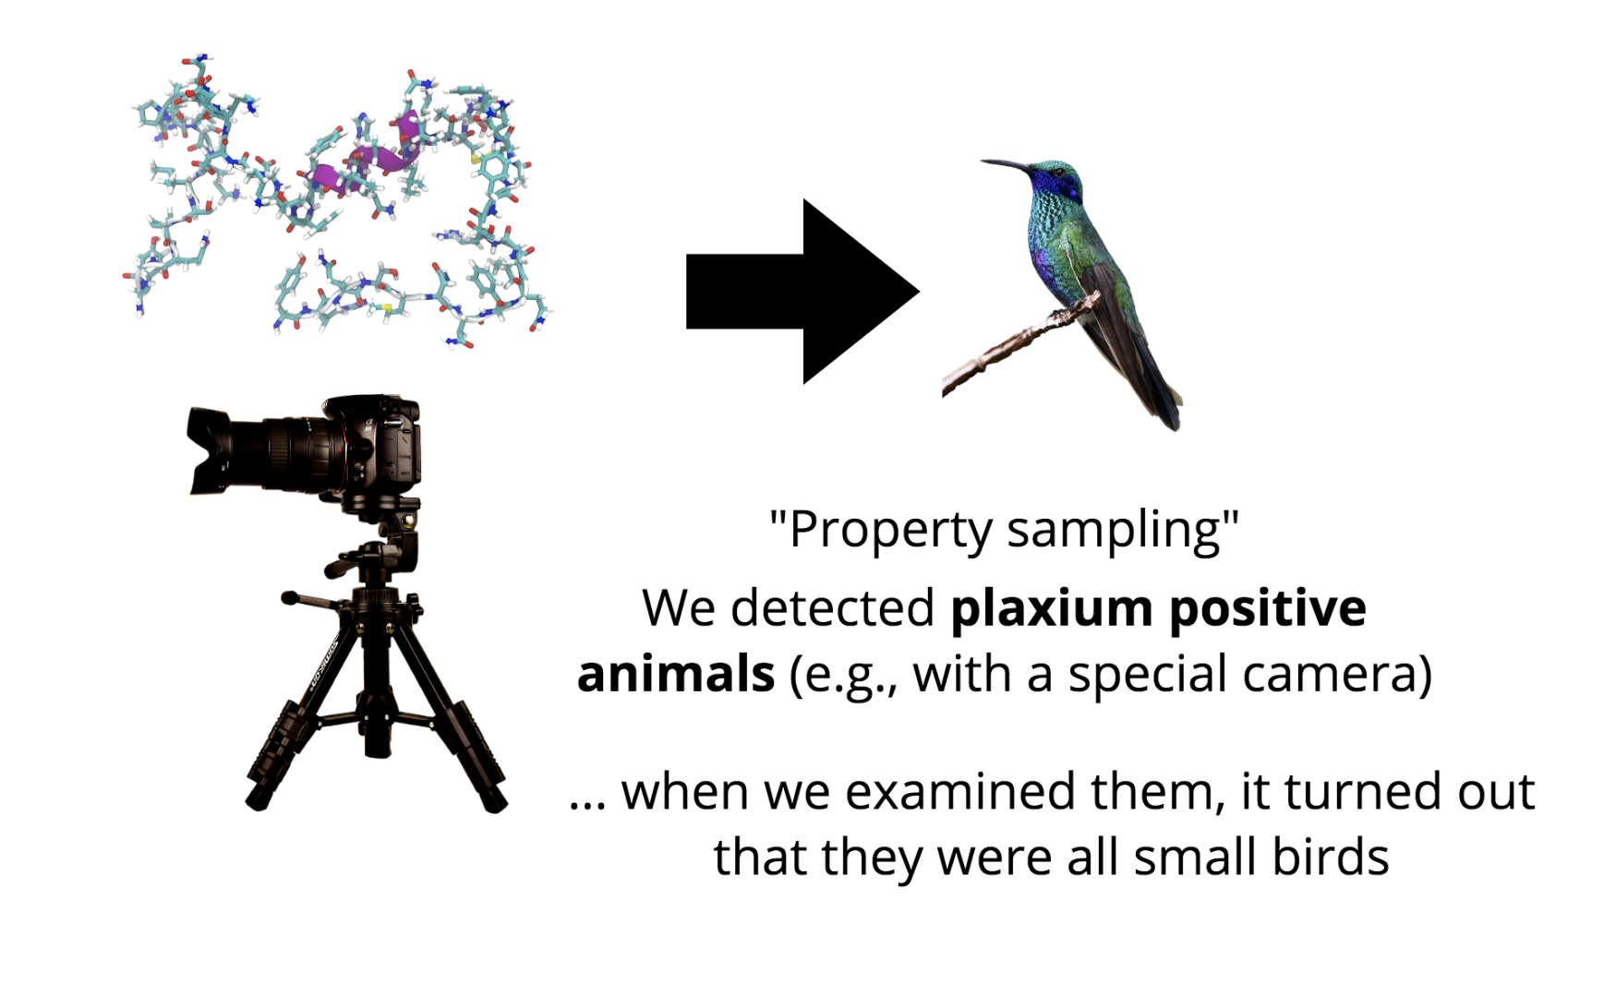

Slide 36
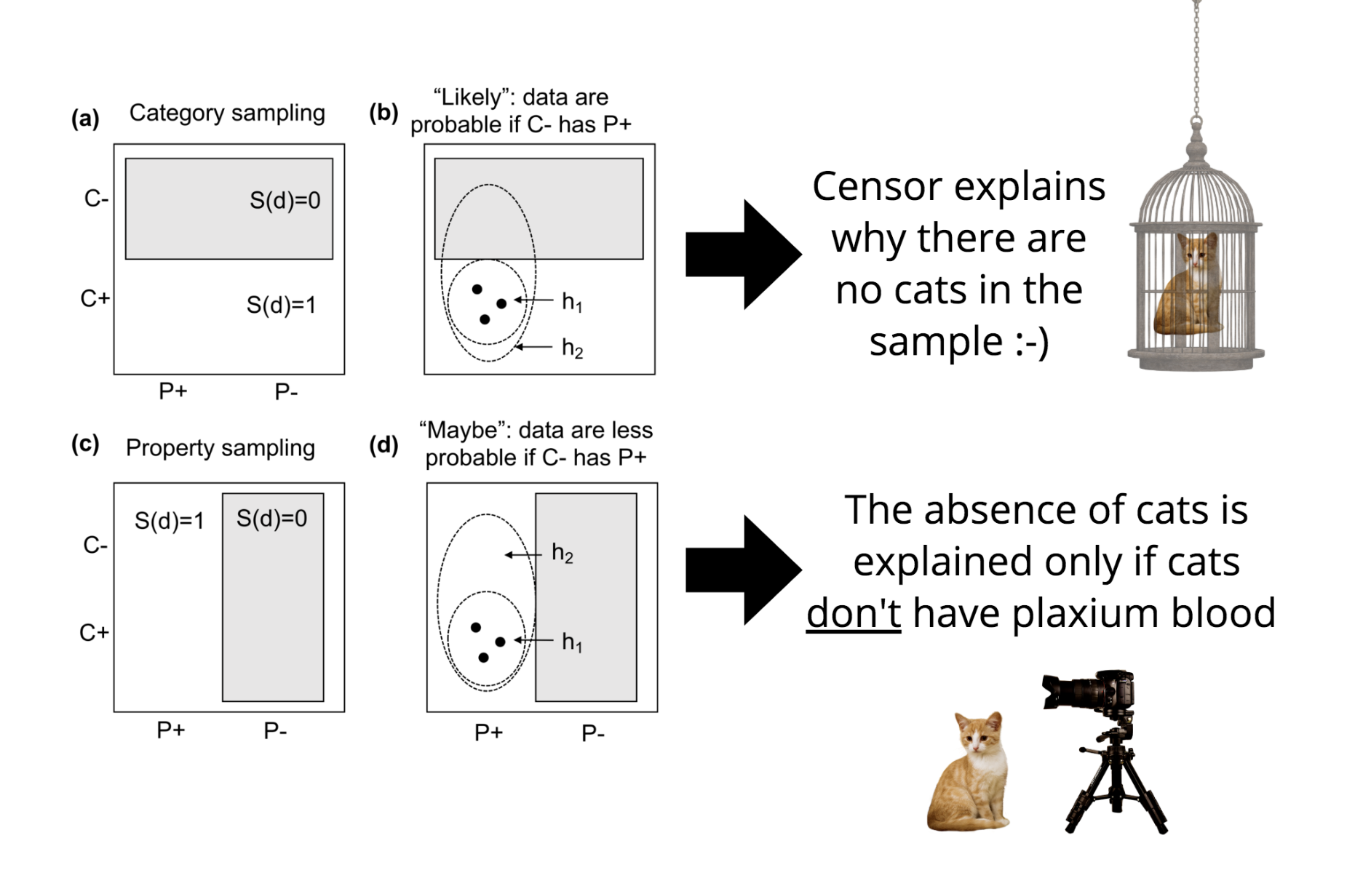

Slide 37
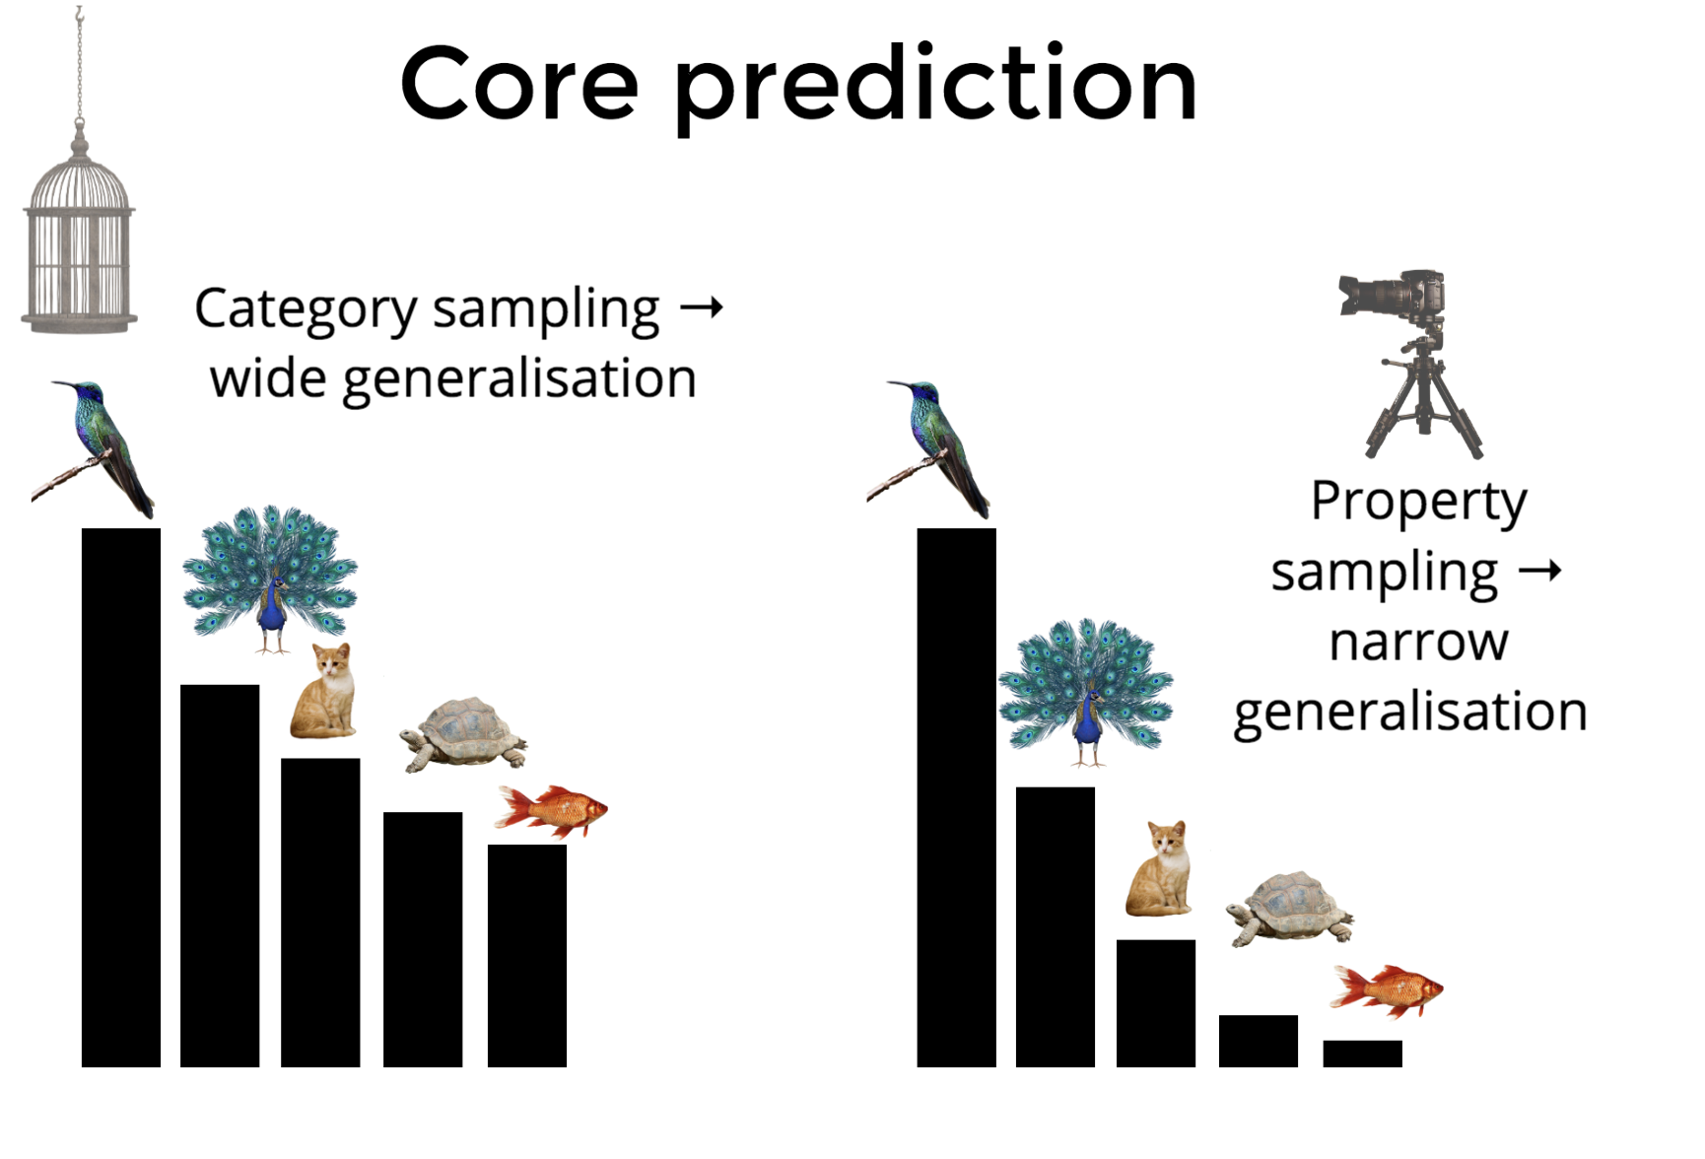

Slide 38
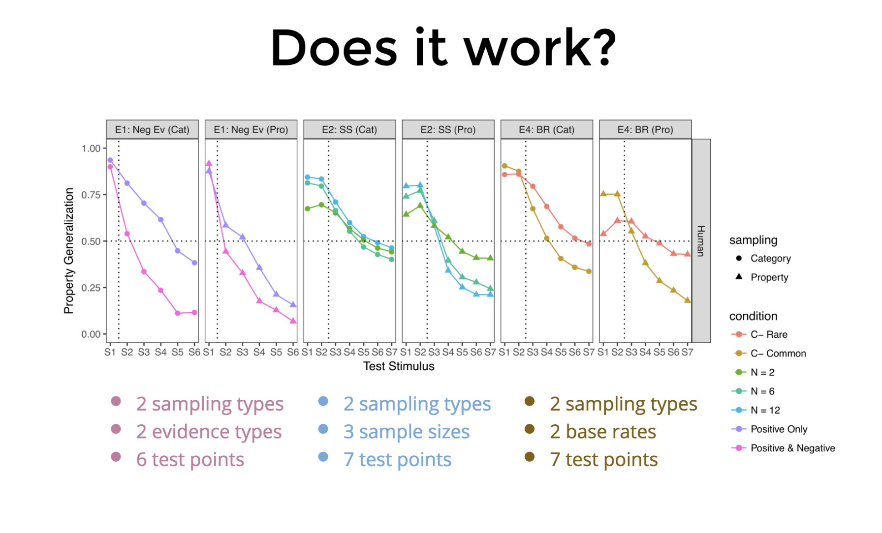

Slide 39
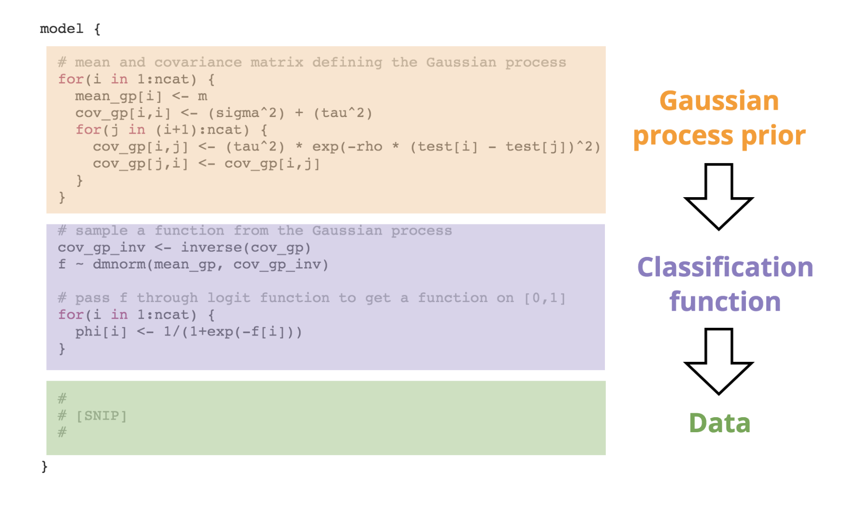
Some fancy-pants modelling in which I show off… BLAH BLAH BLAH… no-one cares ☺…

Slide 40
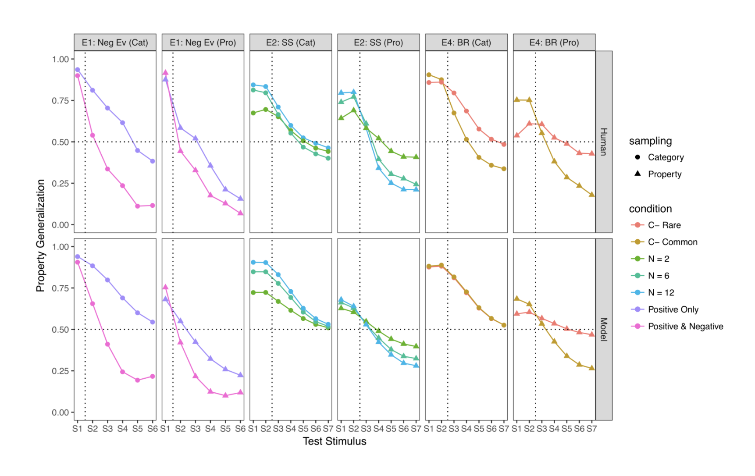

Slide 41

“Do computational models in cognitive science and neuroscience really help us build intelligent machines?
(surprisingly, yes!)

Slide 42
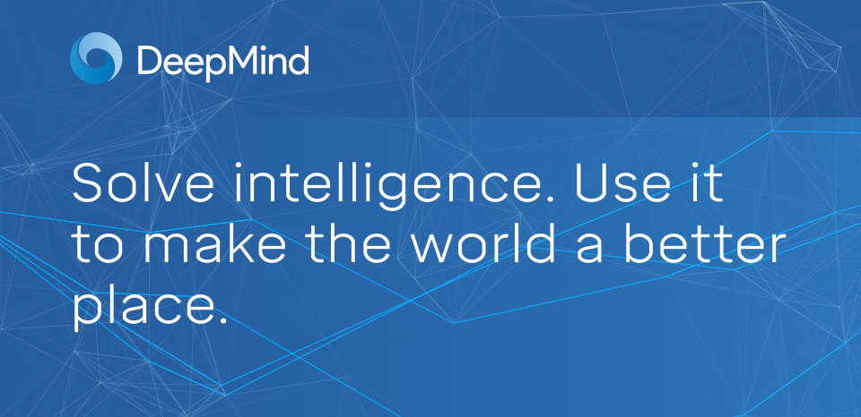
Hm… I wonder what Google are up to these days?

Slide 43
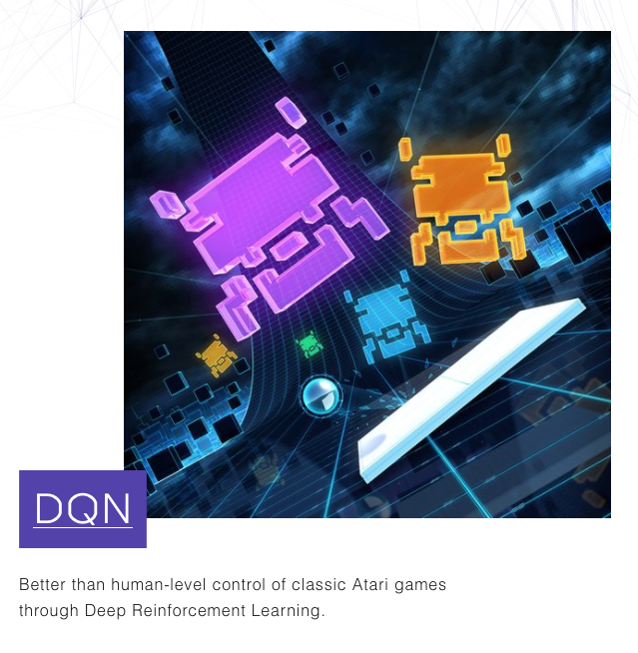
Oh, okay, teaching machines to play Atari games using… reinforcement learning

Slide 44
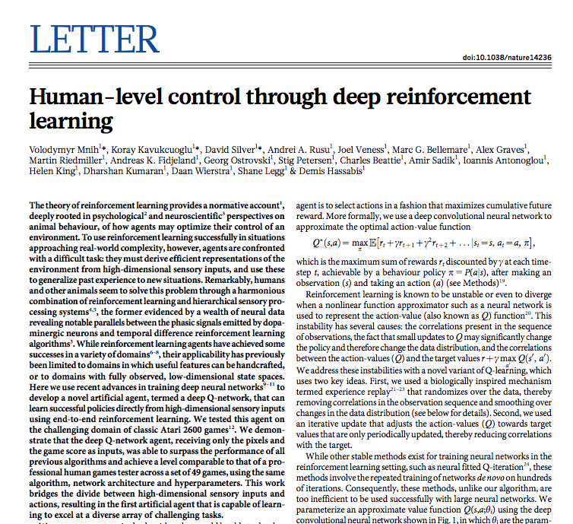
https://storage.googleapis.com/deepmind-media/dqn/DQNNaturePaper.pdf

Slide 45
The theory of reinforcement learning provides a normative account, deeply rooted in psychological and neuroscientific perspectives on animal behaviour, of how agents may optimize their control of an environment. To use reinforcement learning successfully in situations approaching real-world complexity, however, agents are confronted with a difficult task: they must derive efficient representations of the environment from high-dimensional sensory inputs, and use these to generalize past experience to new situations

Slide 46
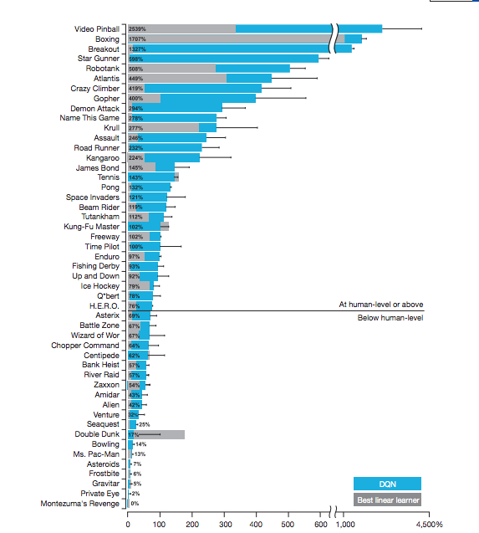
Don’t try to defeat an AI at space invaders
You’ll do much better at Ms Pac-Man

Slide 47
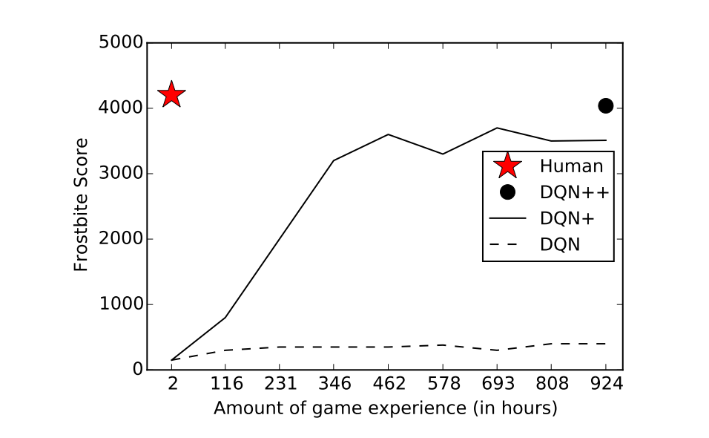
Cognitive science researchers interested in working out why humans are better than AI at some games, and worse at others…
http://web.stanford.edu/class/psych209/Readings/LakeEtAlBBS.pdf

Slide 48
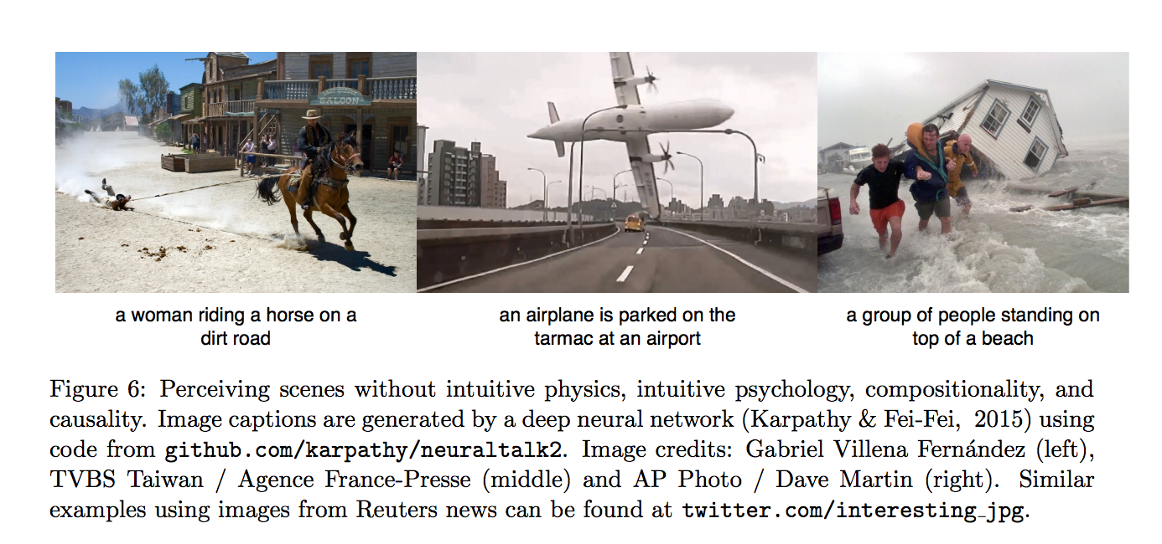
Cognitive science researchers interested in working out why humans are better than AI at some games, and worse at others…
http://web.stanford.edu/class/psych209/Readings/LakeEtAlBBS.pdf

Slide 49

Any other questions???

Slide 50

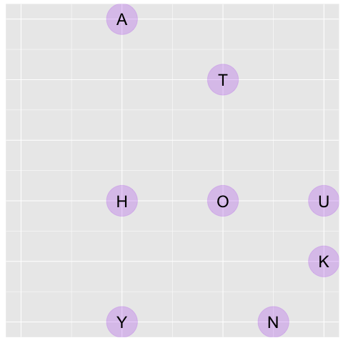
A/Prof Danielle Navarro
d.navarro@unsw.edu.au
compcogscisydney.org
Learning, reasoning, induction, decision making, computational modelling, statistics

